Slide 1
Biosynthesis of Amino Acids

Slide 2
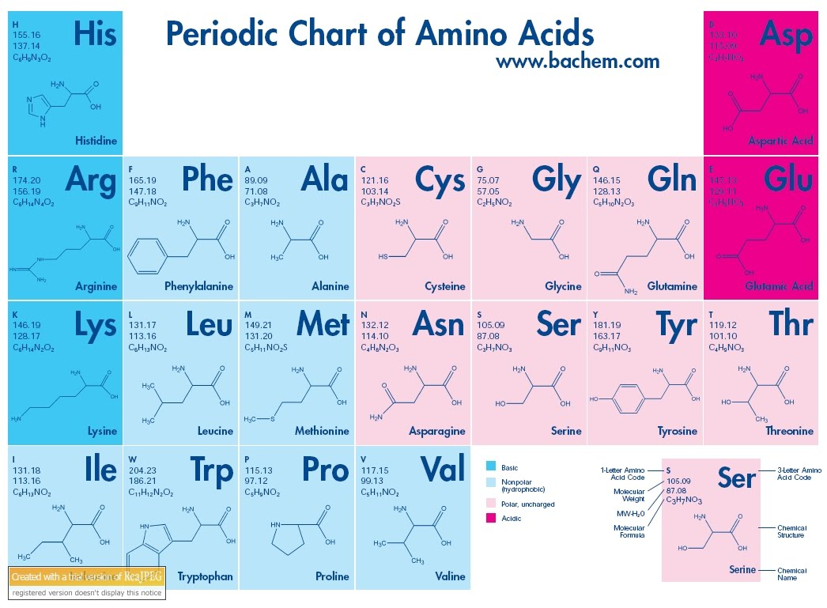

Slide 3
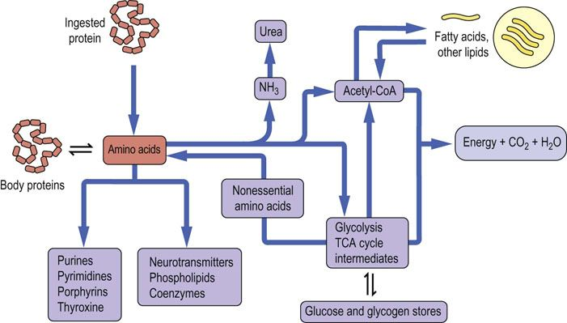
Metabolic relationship of Amino Acids

Slide 4
Biosynthesis of Amino Acids
The carbon skeletons of many amino acids may be derived from metabolites in central pathways, allowing the biosynthesis of some, but not all, the amino acids in humans.
Amino acids that can be synthesized in this way are therefore not required in the diet (nonessential amino acids)

Slide 5
The amino acids having carbon skeletons that cannot be derived from normal human metabolism must be supplied in the diet (essential amino acids)
For the biosynthesis of non-essential amino acids, amino groups must be added to the appropriate carbon skeletons
This generally occurs through the transamination of an α-keto acid corresponding to that specific amino acid.

Slide 6
Based on the principles of nutritional biochemistry, it was estimated that human require ten of the twenty amino acids in their diet in order to thrive.
The ten amino acids are called essential amino acids whereas, the other ten amino acids which humans can synthesize on their own, are called non-essential amino acids

Slide 7
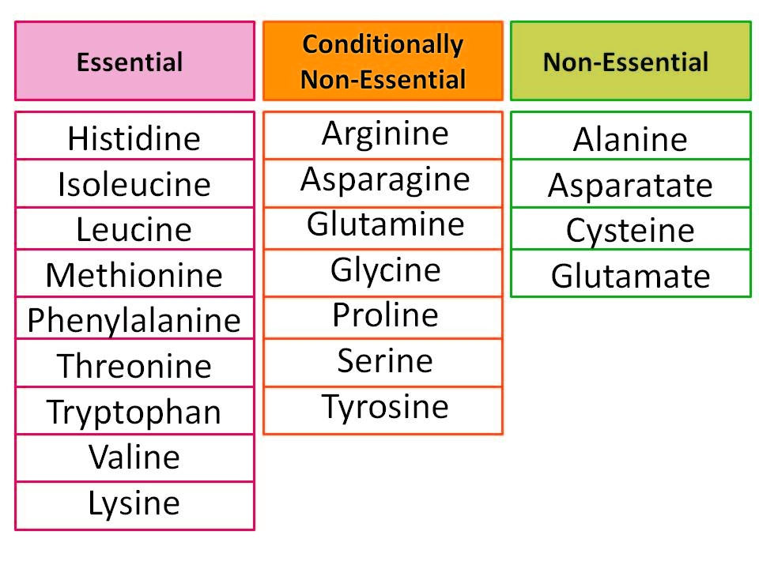

Slide 8
Overview of Amino Acid Biosynthesis
The carbon skeletons of all twenty amino acids are derived from just seven metabolic intermediates, that together, are found in three metabolic pathways. These include:
  Three glycolytic pathway intermediates
    3-phosphoglycerate
    3-phosphoenolpyruvate
    puruvate

Slide 9
Two pentose phosphate pathway intermediates
  Ribose 5- phosphate
  erythrose 4-phosphate
Two citrate cycle intermediates
  α-ketoglutarate and oxaloacetate

Slide 10
Non-Essential
  Transamination of α-ketoacids that are available as common intermediates
  All except tyrosine are derived from one of the following common intermediates:
    Pyruvate
    Oxaloacetate
    α-ketogenic
    3-phosphoglycerate
Essential
  Their α-ketoacids are not common intermediates (Enzymes needed to form them are lacking)

Slide 11
Amino Acid Biosynthetic families, grouped by metabolic precursors

Slide 12
The amino acids that are precursors for other amino acids are shown in yellow.
The nine essential amino acids are shown in boldface.

Slide 13
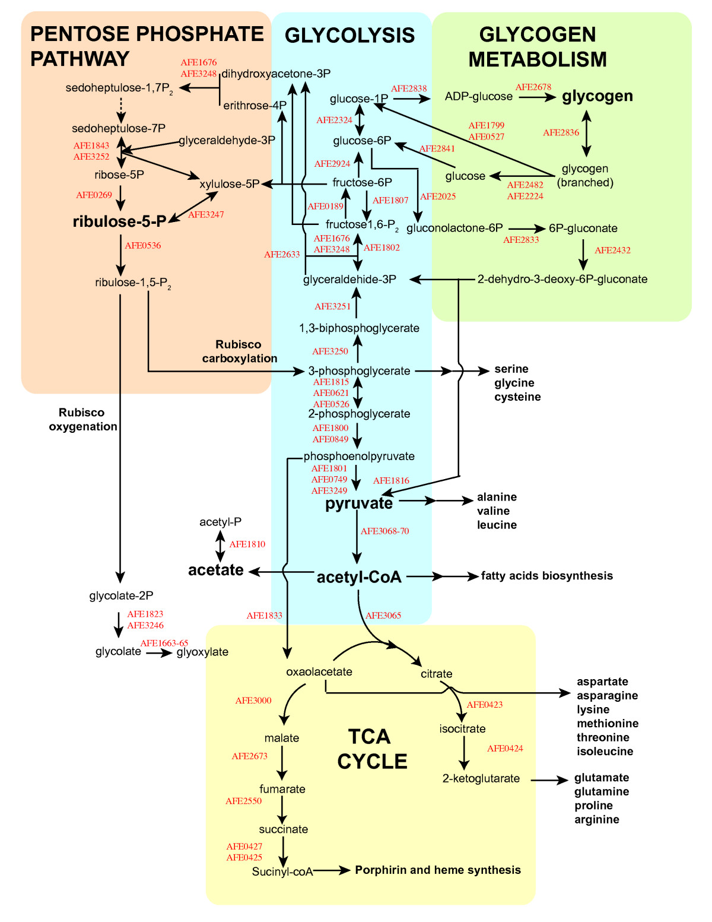

Slide 14
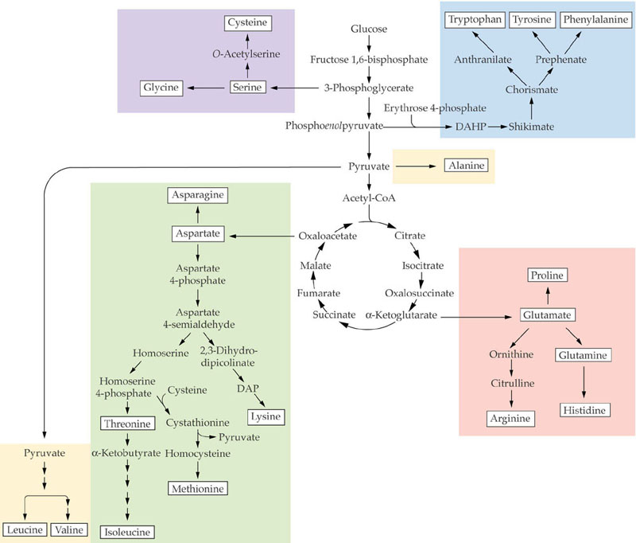

Slide 15
Biosynthesis of Aspartate
Aspartate can be synthesized by the body, so it is classified as a non-essential amino acid.
In human, aspartate is most frequently synthesized through the transamination of oxaloacetate.
Transamination, a chemical reaction that transfers an amino group to a ketoacid to form new amino acids.

Slide 16
The biosynthesis of aspartate is facilitated by an aminotransferase enzyme: the transfer of an amine group glutamine yields aspartate and an alpha-keto acid
Aspartate is also a by product of the urea cycle.

Slide 17
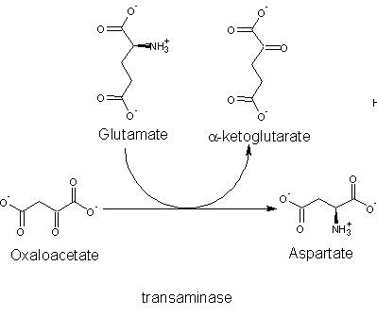

Slide 18
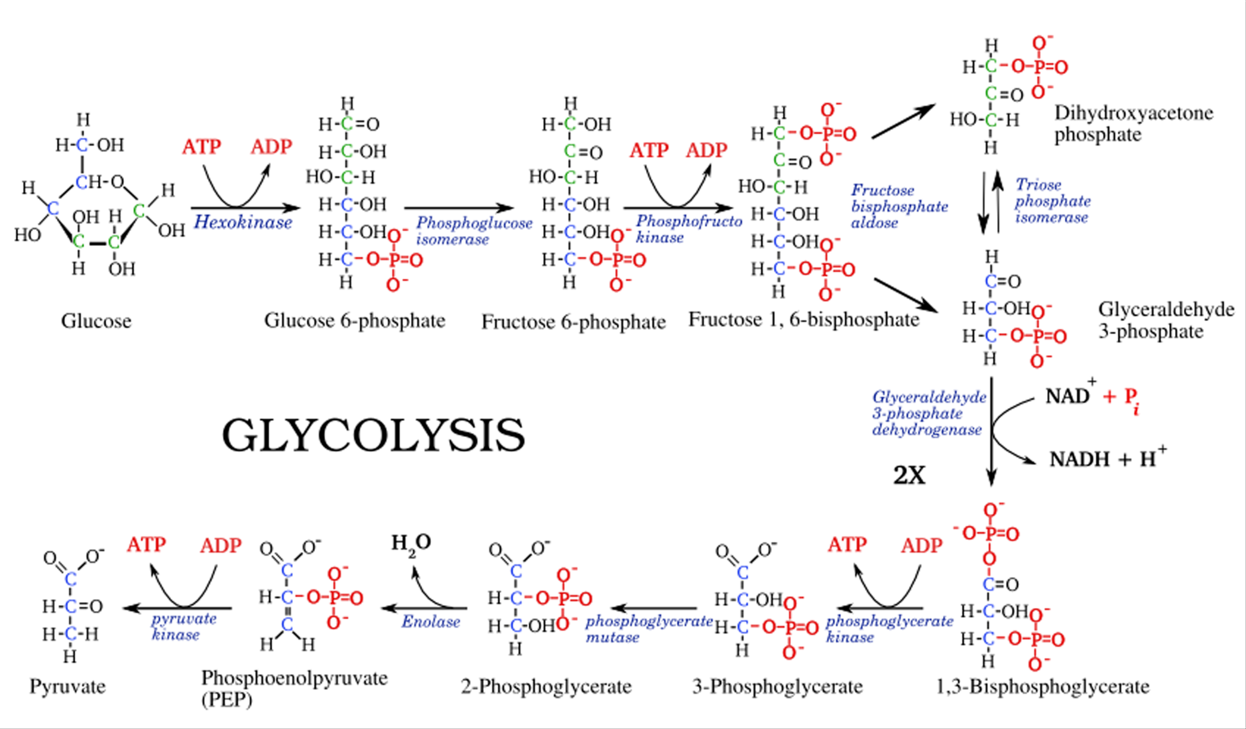
Biosynthesis of Pyruvate

Slide 19
Aromatic amino acids
Aromatic amino acids are amino acids that include an aromatic ring. Among 20 standard amino acids:
  Phenylalanine
  Tryptophan
  Tyrosine
  Histidine
Aromatic amino acids are able to absorb light due to their conjugated double bonds. This characteristic of aromatic amino acids is used to quantify the concentration of proteins in an unknown sample.

Slide 20
Phenylalanine, tryptophan, and histidine are essential amino acids for animals.
Since they are not synthesized in the human body, they must be derived from the diet.
Tyrosine is semi-essential; it can be synthesized, but only from phenylalanine.
A lack of the enzyme phenylalanine hydroxylase, used in tyrosine synthesis, causes phenylketonuria and concurrently renders tyrosine an essential amino acid.

Slide 21
Biosynthesis of Aromatic amino acids
Synthesis of the aromatic amino acids begins with the synthesis of chorismate - an important intermediate for many biosynthetic pathways.
Phosphoenol pyruvate and erythrose 4-phosphate serve as beginning substrates for the pathway.
A price of one NADPH + H⁺ and one ATP is exacted for every chorismate formed.
In the sixth step of the synthesis another phosphoenol pyruvate molecule is added to the growing molecule

Slide 22
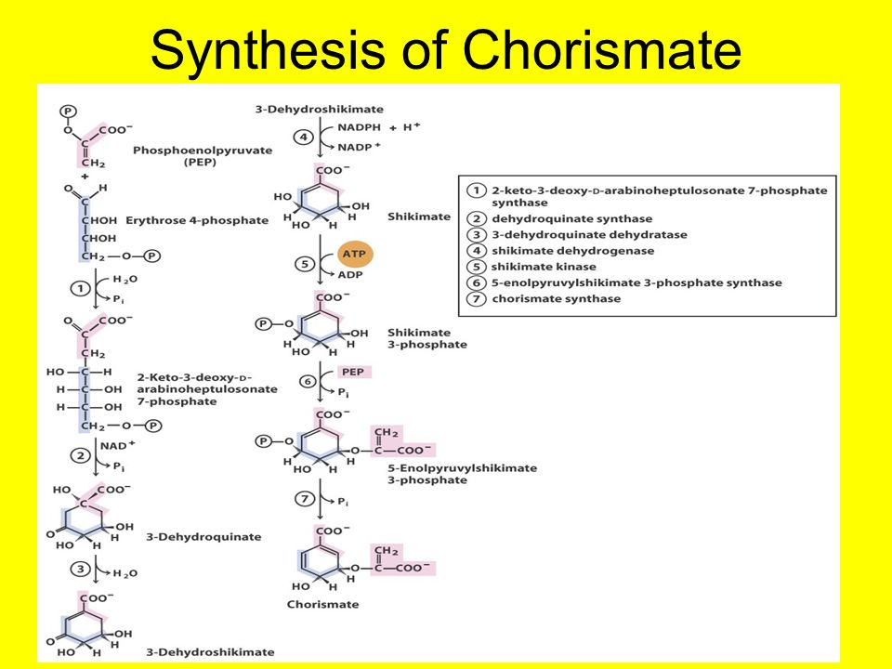

Slide 23
Biosynthesis of Tryptophan
Tryptophan synthesis is complex and involves 5 steps from chorismate.
Glutamate donates an amine group in the first step of the pathway and pyruvate is lost from chorismate.
In the next threes steps a ribose sugar is added, this eventually contributes to the 5 membered ring of tryptophan.
Energy is contributed to the process in the form of hydrolysis of pyrophosphate.
This hydrolysis helps drive the addition of the ribose sugar in the second step of the reaction.
In the last step of the pathway serine serves as the donor of the a carbon amino group of tryptophan.

Slide 24
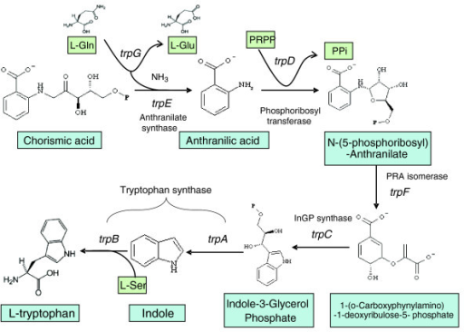

Slide 25
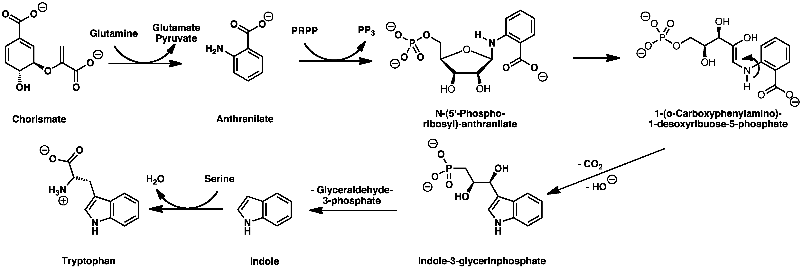

Slide 26
Biosynthesis of Phenylalanine and Tyrosine
Phenylalanine
  Chorismate is converted to phenylpyruvate in two steps and phenylalanine is synthesized by a transamination reaction with glutamate.
  No energy is require to run these reactions

Slide 27
Tyrosine
  The synthesis of tyrosine is very similar to the synthesis of phenylalanine, but the reactions are carried out by different enzymes under different regulatory control.
  NADH is created in the formation of 4-hydroxyphenylpyruvate.
  Tyrosine is made by a similar transamination reaction as that seen in phenylalanine synthesis.

Slide 28
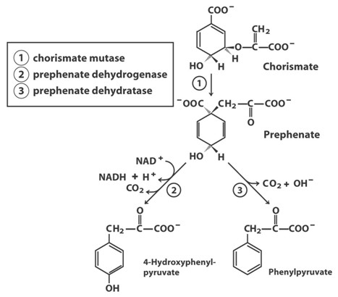

Slide 29
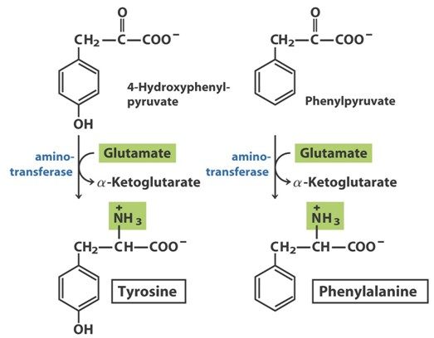

Slide 30
Biosynthesis of Histidine
The synthesis of histidine is long and complex and its pathway is intertwined with nucleic acid biosynthesis (specifically purine).
The pathway seems to be universal in all organisms able to synthesize histidine.
The first five steps of the pathway take ribose from phosphoribosyl pyrophosphate (PRPP) and transform it into Imadiazole glycerol phosphate.
Once the imadiazole ring is formed, glutamate donates the a-amino group and the newly formed amine is oxidized to histidine in the last step of the pathway.
Energy is required in the form of ATP and pyrophosphate which is lost from phosphoribosyl pyrophosphate and ATP help drive the reaction.

Slide 31
